Slide 1
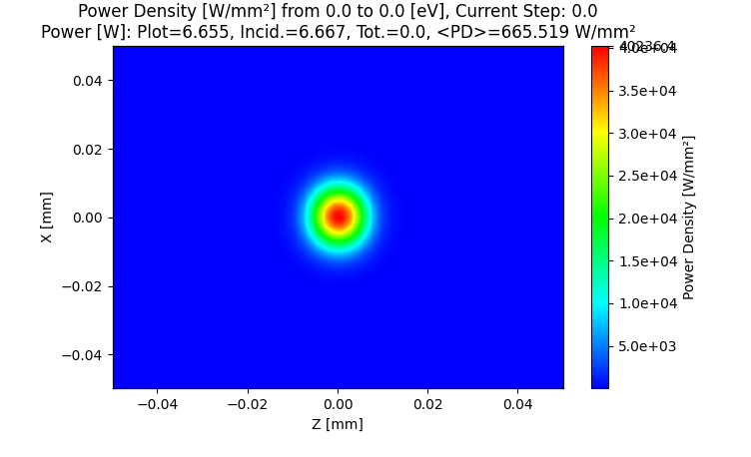
Thermal Load Loops
Luca Rebuffi (ANL)
Beamline Optics Design and Simulation Workshop
Hamburg, Germany
May 19-22, 2025
Notes:
Univ of Chicago Review, Aug. 30, 2010
1

Slide 2
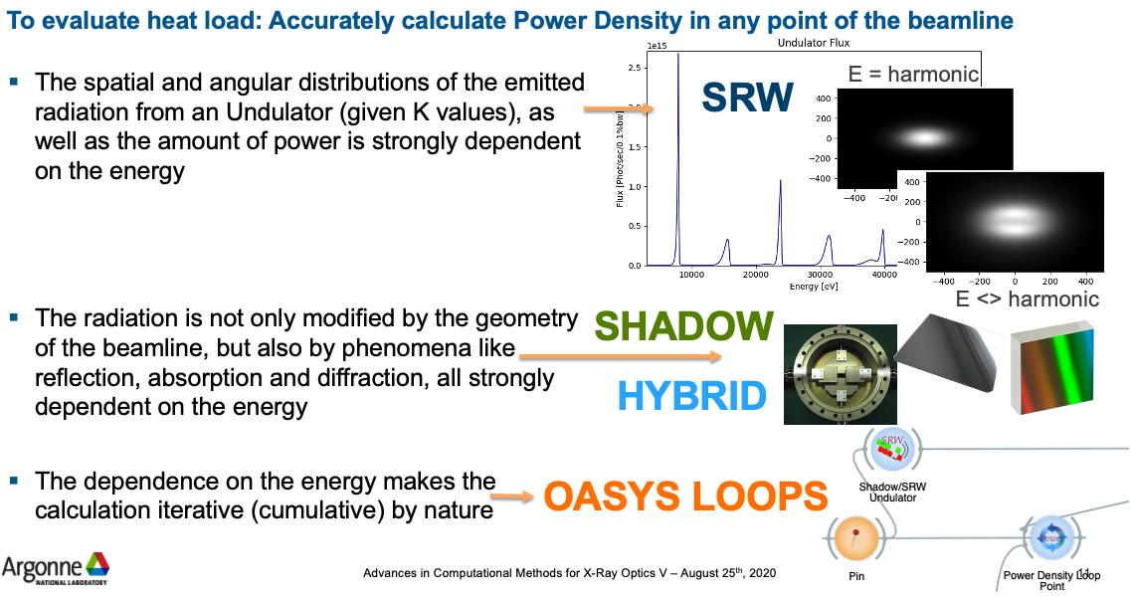
Thermal Load Loops

Slide 3
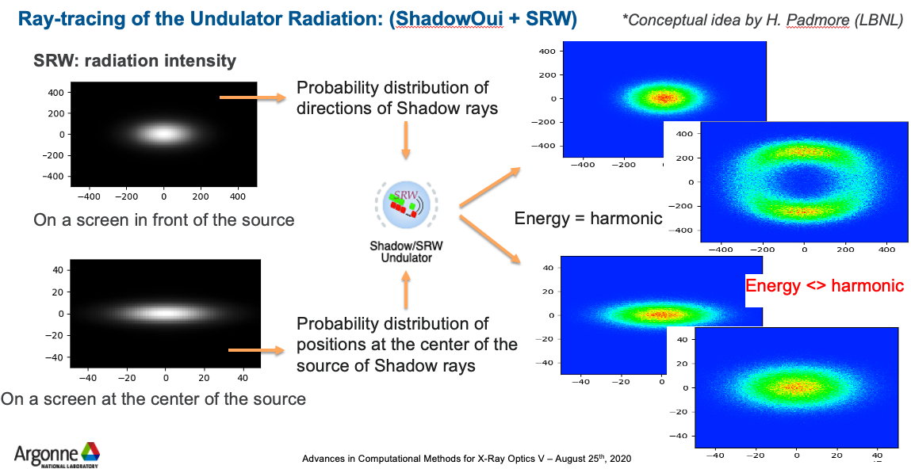
Thermal Load Loops: Undulator Source

Slide 4
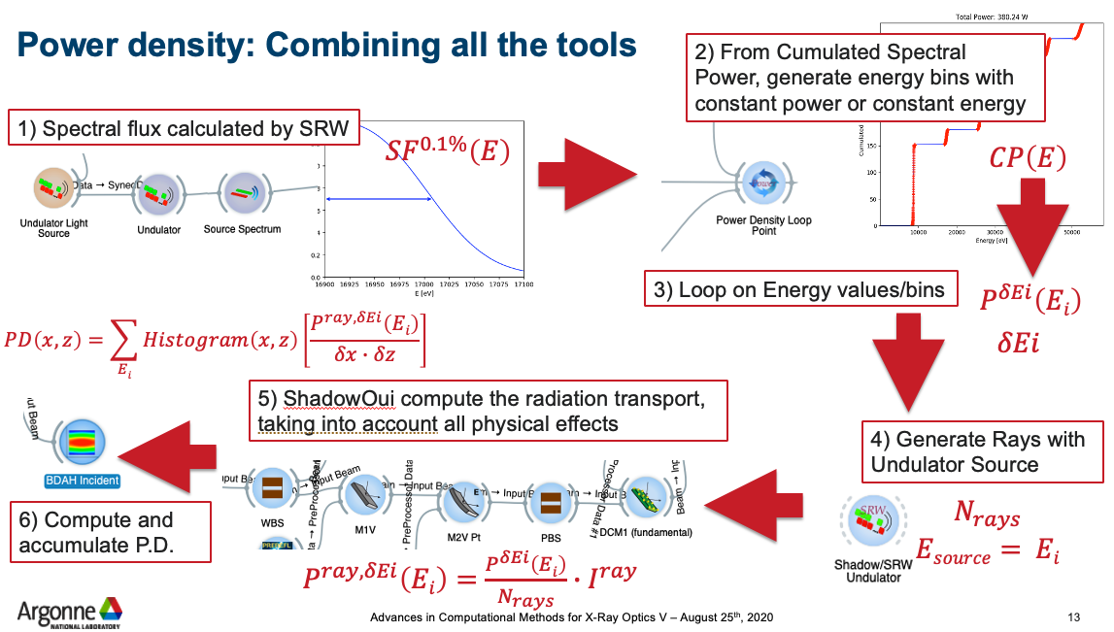
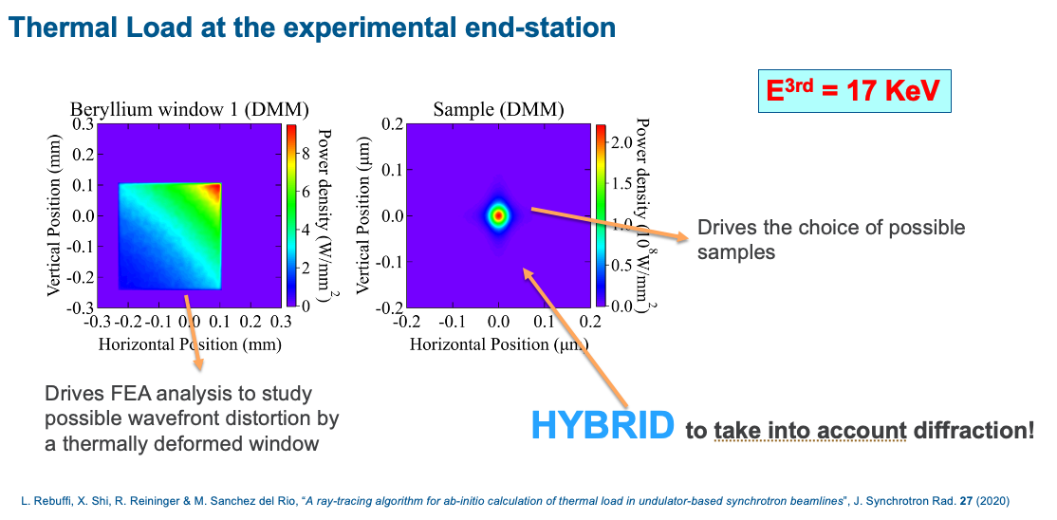
Thermal Load Loops: Power Density

Slide 5
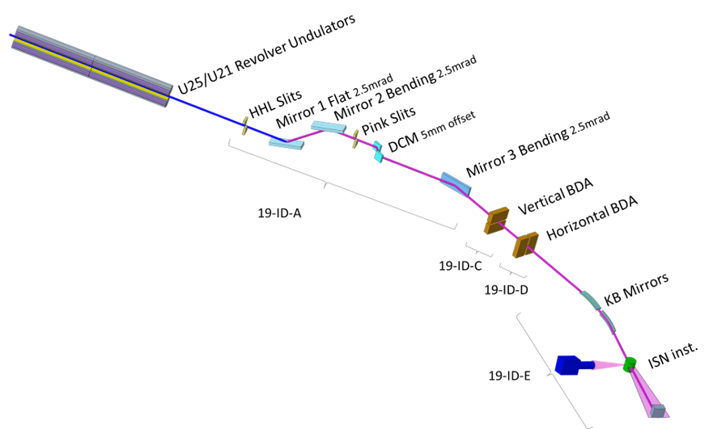
ISN Beamline
Distance (m) | Component | Dimension (mm²) | Description/Comments
27.0 | Slit | 1 × 1 | White beam slit
28.0 | Mirror (M1) | 10 × 400 | Vertical, upward reflecting, flat mirror
29.0 | Mirror (M2) | 10 × 400 | Vertically focusing mirror, downward reflecting
31.7 | DCM | 10 × 200 | Double crystal monochromator
32.7 | DMM | 10 × 200 | Double multilayer monochromator
34.0 | Mirror (M3) | 10 × 400 | Horizontally focusing, outward reflecting
55.0 | BDA-V | NA | Vertical beam defining aperture
64.0 | BDA-H | NA | Horizontal beam defining aperture
219.604 | V-KB | 10 × 400 | Nanofocusing Vertical K-B mirror
219.8745 | H-KB | 10 × 125 | Nanofocusing Horizontal K-B mirror
220.0 | Sample |  | Sample Position
E^{3rd} = 17 KeV
Undulator U25 at APS-U
Period (mm) | Number of Periods | K | E_{1st} (keV) | Electron Beam
 |  |  |  | E (GeV) | I (mA) | σ_{x} (µm) | σ_{y} (µm) | σ_{x}’ (µrad) | σ_{y}’ (µrad)
25 | 184 | 1.6812 | 5.667 | 6 | 200 | 14.8 | 3.7 | 2.8 | 1.5

Slide 6
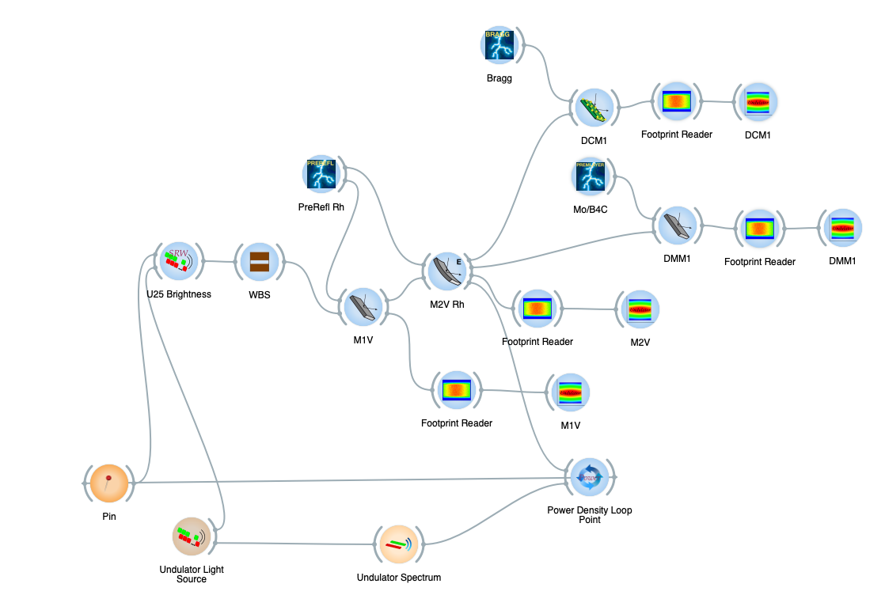
ISN: OASYS Simulation
Mirrors and Monochromator

Slide 7
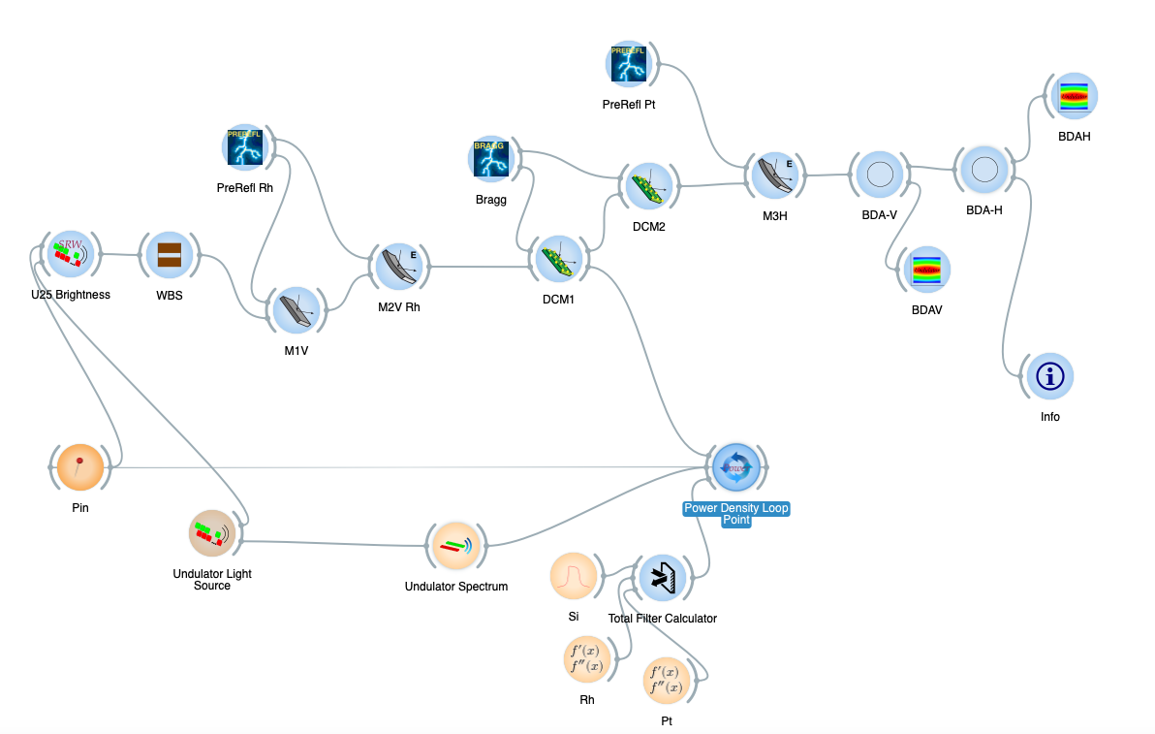
ISN: OASYS Simulation
BDAs + DCM

Slide 8
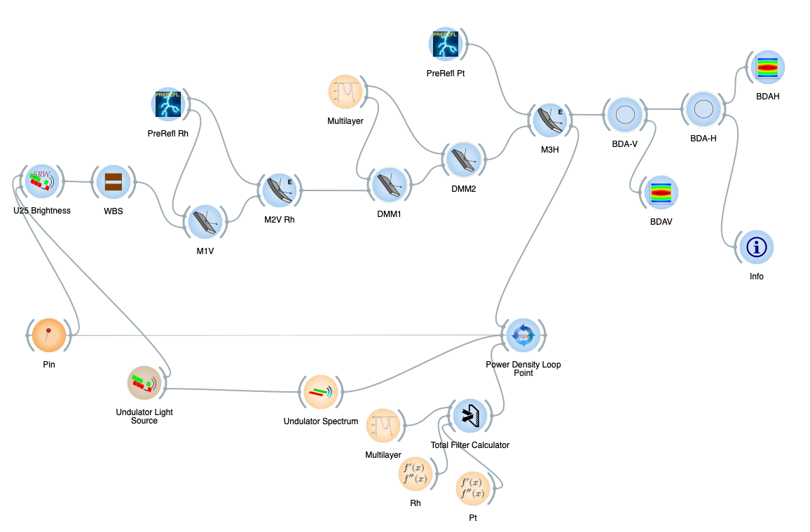
ISN: OASYS Simulation
BDAs + DMM

Slide 9
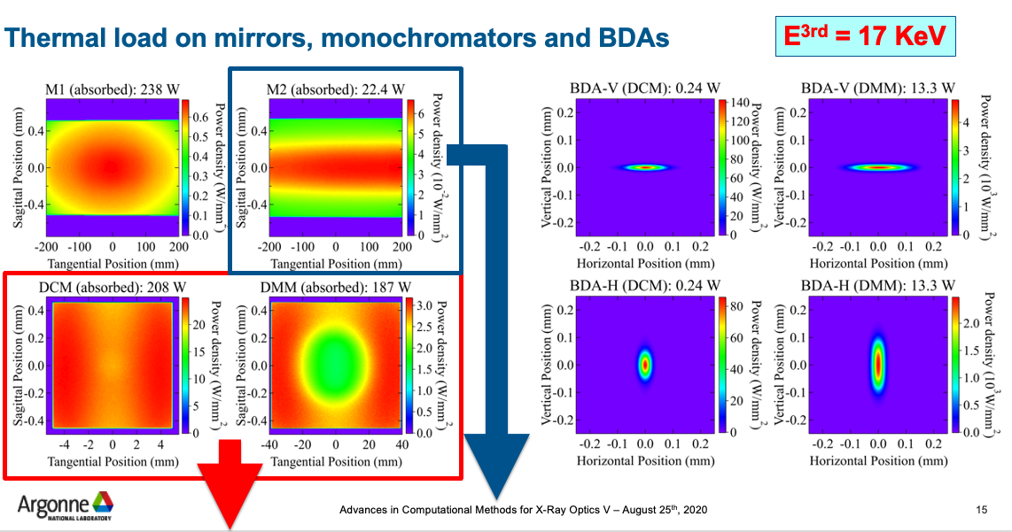
ISN: Mirrors, Monochromators and BDAs

Slide 10
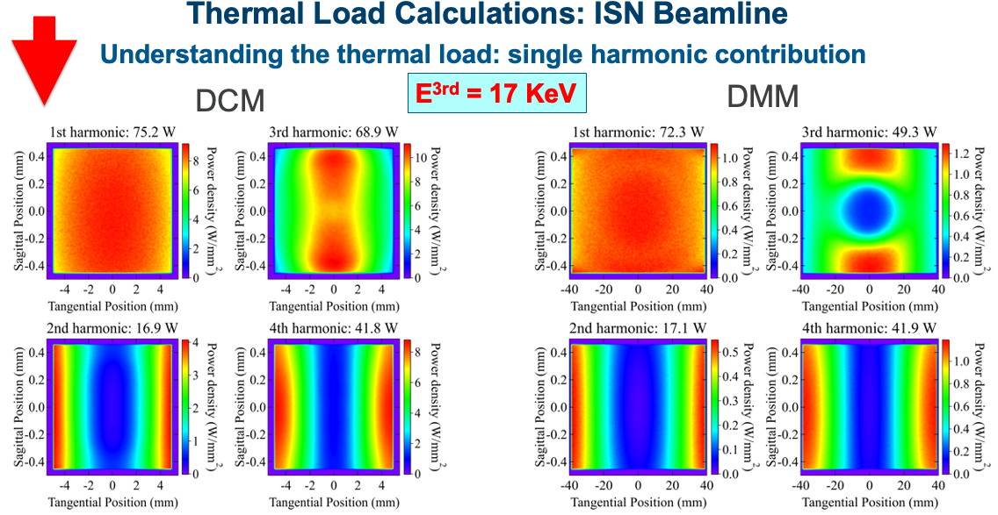
ISN: Mirrors, Monochromators and BDAs

Slide 11
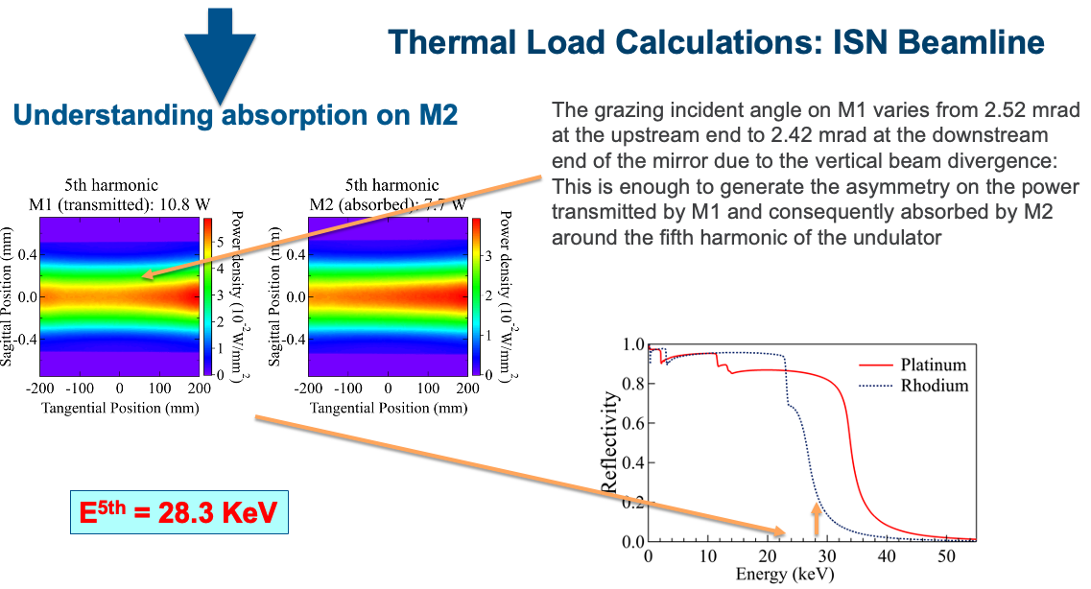
ISN: Mirrors, Monochromators and BDAs

Slide 12
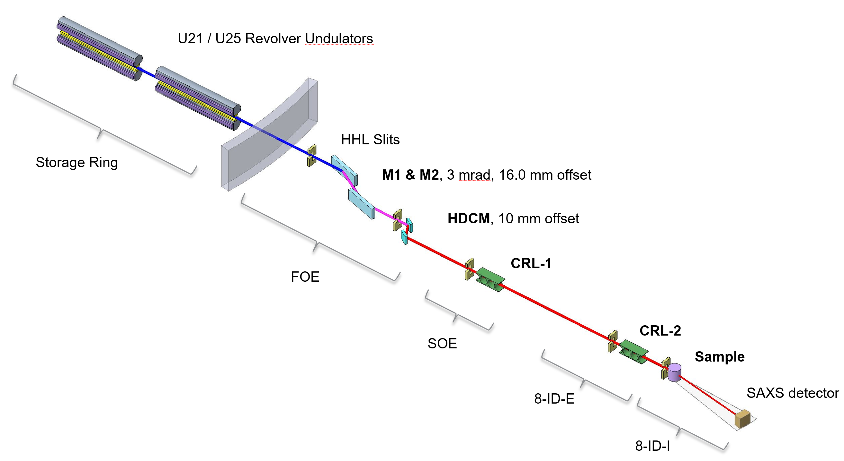
XPCS: Accidental Focusing on RSS components
Component | Distance (m) | Description/Comments
Mask | 25.5 | Front end mask
Mirror | 28.0 | Horizontal reflecting, flat
Mask | 29.6 | WB Stop, 2x2 mm
Mirror | 30.6 | Horizontal reflecting, flat, bendable
DMM | 48.8 | HDMM
Mask | 49.7 | PB Stop, 2x2 mm
CRL1 | 52.0 | Transfocator, focusing
SH3 | 61.3 | Photon Shutter
CRL2 | 62.0 | Transfocator, focusing
BS1 | 80.0 | Beam Stop
E^{1st} = 11 KeV
Undulator U21 at APS-U
Period (mm) | Number of Periods | K | E_{1st} (keV) | Electron Beam
 |  |  |  | E (GeV) | I (mA) | σ_{x} (µm) | σ_{y} (µm) | σ_{x}’ (µrad) | σ_{y}’ (µrad)
21 | 224 | 0.9797 | 11.0 | 6 | 200 | 14.8 | 3.7 | 2.8 | 1.5

Slide 13
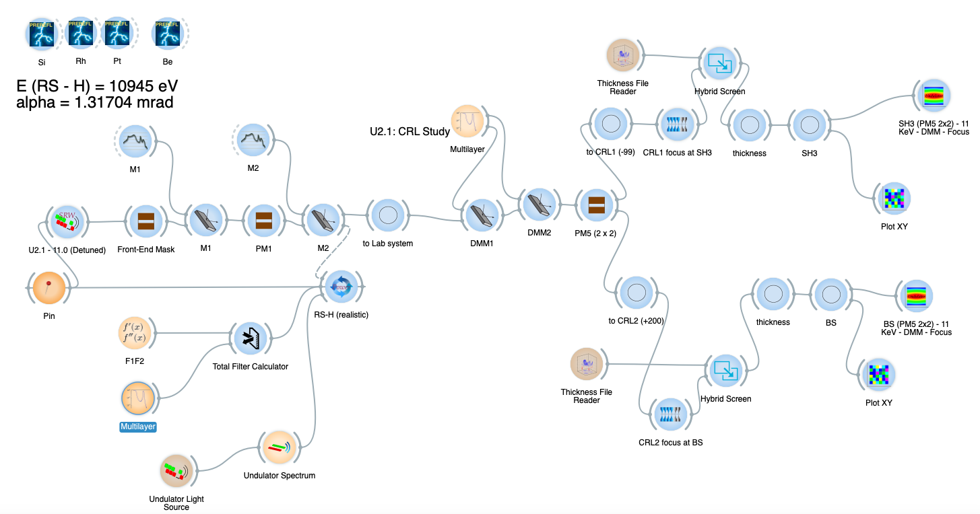
XPCS: OASYS Simulation

Slide 14
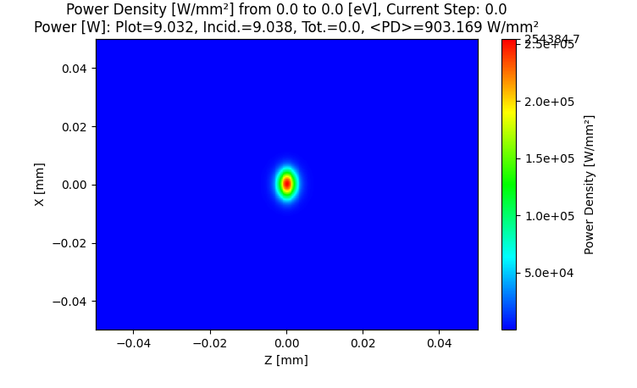
XPCS: Without realistic features
SH3
BS1
Total Power: 9.0 W
Peak Power Density: 254.4 kW/mm²
Total Power: 6.7 W
Peak Power Density: 40.9 kW/mm²

Slide 15
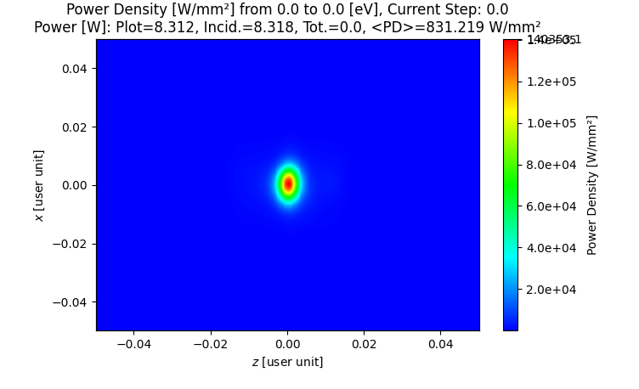
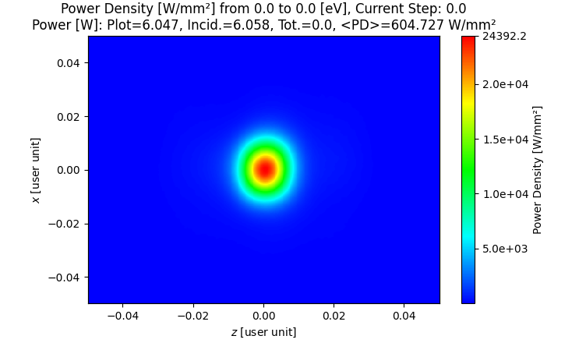
XPCS: Accidental Focusing on RSS components
SH3
BS1
Total Power: 8.3 W
Peak Power Density: 142.0 kW/mm²
Total Power: 6.0 W
Peak Power Density: 24.4 kW/mm²

